Slide 1
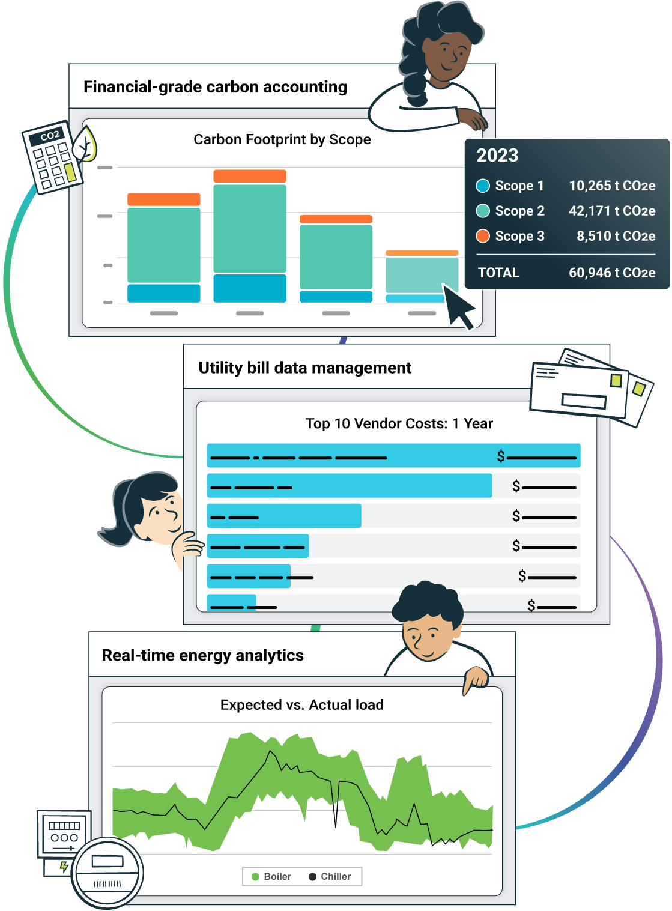
The #1 trusted energy and sustainability ERP

Slide 2
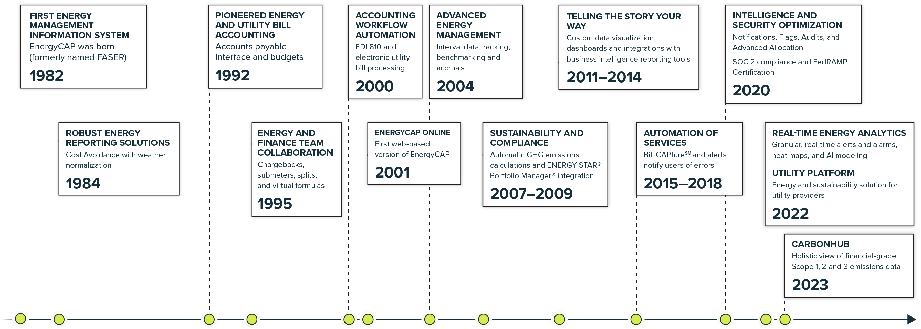
Over 40 years of innovation and leadership

Slide 3































































































Diverse and dedicated client base
Utility Companies
Government
Education
Commercial
City
Public School Districts
General commercial and retail
Ind/manufacturing
Energy services/consultants
State/Providence
Public higher ed/University Systems
Healthcare
Transportation
Federal
County/Federal
Private education
Property mgmt/Real estate

Slide 4
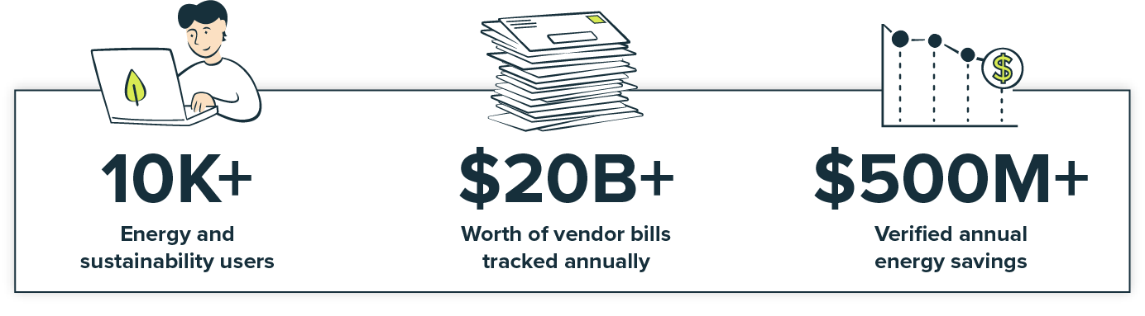
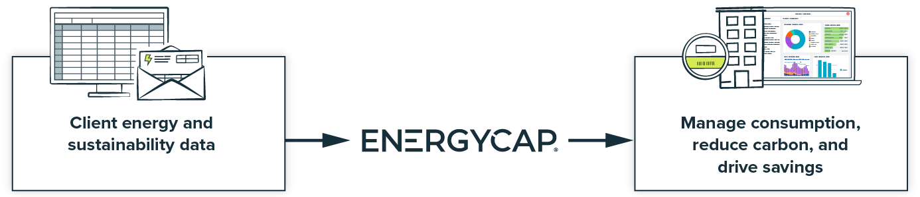
EnergyCAP is the #1 trusted energy and sustainability ERP

Slide 5



A single platform for the entire team
The EnergyCAP ERP brings energy, sustainability, and finance teams together to capture, allocate, analyze, and report the data the way they want it.
Energy managers
Operate from one single source of truth with accurate and
reliable data. Create, verify, and visualize the energy program you need now.
Sustainability leaders
Automatically convert your data into greenhouse gas emissions and provide a holistic view of sustainability across your organization.
Finance leaders
Get a tool that supports the unique demands of energy accounting. With EnergyCAP, you get a partner that enhances your already-predictable system.

Slide 6



Energy and sustainability ERP // The single source of truth
Get instant access to validated, actionable data you can trust to better manage resource consumption,
reduce your carbon footprint, reach net-zero, and drive massive savings.
z
Portfolio-level energy and sustainability reporting
Manage and see it all.
Financial-grade greenhouse gas accounting
Target and track emissions.
Real-time energy and sustainability analytics
Dive deep. Respond quickly.
Get accurate and reliable energy and utility data across your entire portfolio and streamline energy and accounting workflows.
Customer Data Type: Utilities/Bill/Resources
Persona:
Finance/energy
An advanced, holistic view of financial-grade emissions data across your business with automatically applied factors to meet your ESG reporting needs.
Customer Data Type:
GHG activities
Persona:
Sustainability
Dive deep into real-time performance
of assets, devices, and sensors. Make quick, data-driven decisions for
high-performance, net-zero buildings.
Customer Data Type:
Time-Series/Interval Energy
Persona:
Energy/facilities
CAPture Services: Bill CAPture, Bill Processing/Managed Services
Notes:
CarbonHub, EnergyCAP and Wattics – in that order

Slide 7
EnergyCAP UtilityManagementTM
(EUM) overview
Notes:
@Dave transitions to Lalit

Slide 8




Utilize an ERP to meet your organization’s data and reporting needs
Capture
Gain timely access to accurate and reliable energy and sustainability information.
Utility bill entry and import
Capture, map, and import via Bill CAPture℠
API integrations
Data formats: paper, PDF, XLS, CSV, TXT, XML, EDI, and more
Allocate
Recoup energy costs from tenants or departments.
Rebill costs using sub-meter data, formulas, and split calculations
Target and track usage, cost, and carbon from measurable or calculated points.
Get as granular as you need
Analyze
Identify outliers in your data and focus on the areas of operation with highest impact.
Utility bill auditing
Energy benchmarking
Measurement and verification
Energy use intensity (EUI)
Integrated charts and graphs
Powerviews
Report
Distribute meaningful information to your team members and stakeholders in a streamlined and automated way.
Library of standard reports
Configurable reports and dashboards
Automated ENERGY STAR submission
Business intelligence integration
Bill accruals and forecasting
Notes:
@Lalit

Slide 9
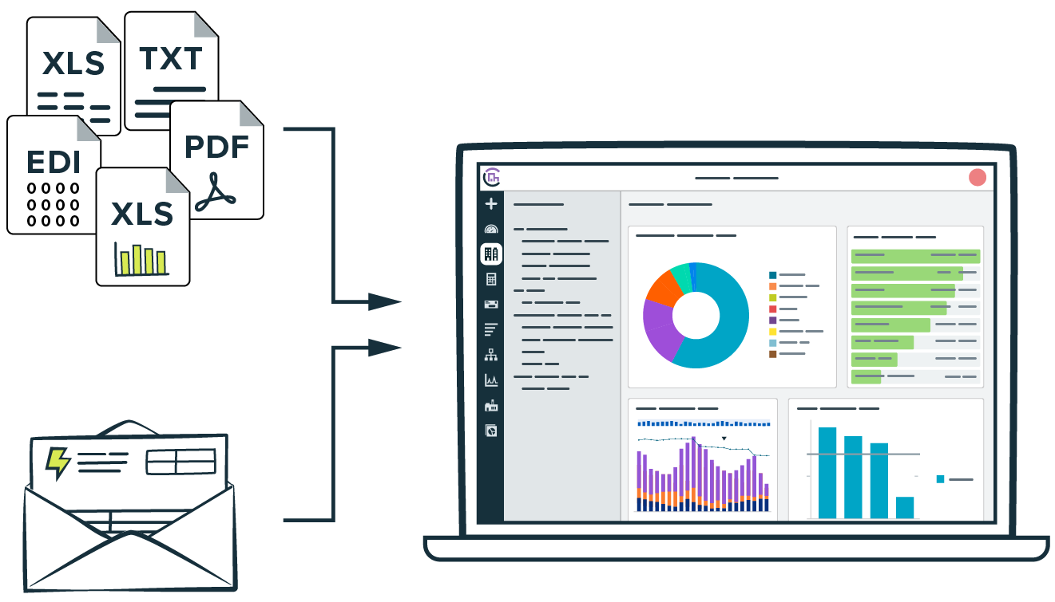
EnergyCAP UtilityManagement // Portfolio-level energy and sustainability reporting
Capture
Gain timely access to accurate and reliable energy and sustainability information from monthly utility bills for financial grade energy and sustainability reporting.
Utility bill entry and import
Capture, map, and import via EnergyCAP Bill CAPture℠
API integrations
Data formats: paper, PDF, XLS, CSV, TXT, XML, EDI, and more
Notes:
@Lalit

Slide 10
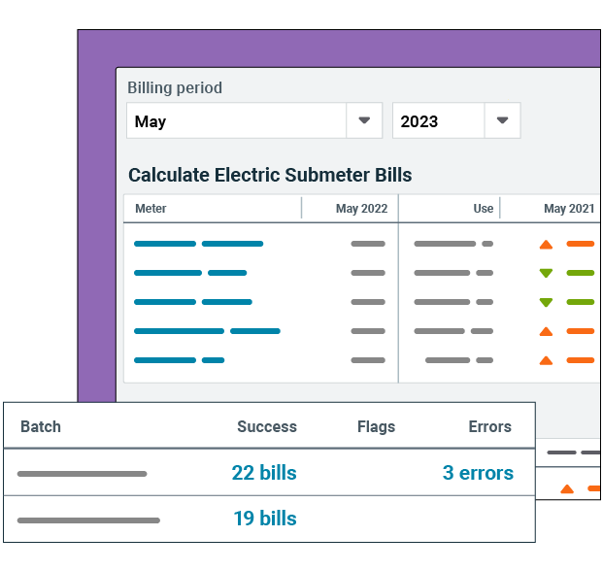
EnergyCAP UtilityManagement // Portfolio-level energy and sustainability reporting
Allocate
Recoup energy costs from tenants or departments by allocating costs using submeter data, formulas, and split calculations with the EnergyCAP UtilityManagement Chargeback feature. Target and track usage, cost, and carbon from measurable or calculated points. Get as granular as you need with the way you allocate costs and consumption.
Notes:
@Lalit

Slide 11
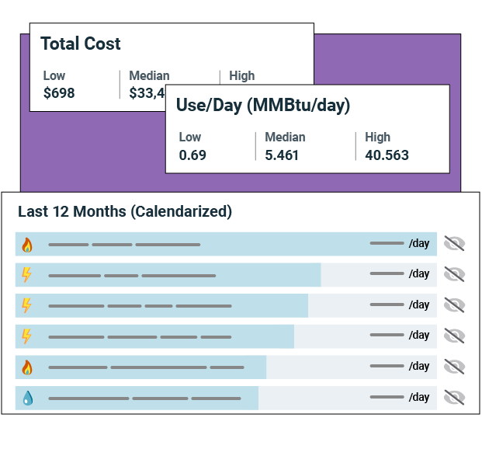
EnergyCAP UtilityManagement // Portfolio-level energy and sustainability reporting
Analyze
Stop searching for a needle in the haystack. EnergyCAP UtilityManagement automatically identifies outliers in your data and points to the exact place you need to look, so you can save time and focus on more meaningful projects.
Utility bill auditing
Energy benchmarking
Measurement and verification
Energy use intensity (EUI)
Notes:
@Lalit

Slide 12
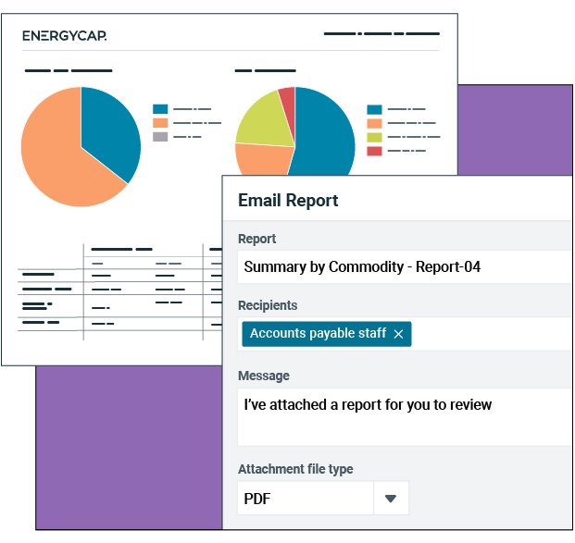
EnergyCAP UtilityManagement // Portfolio-level energy and sustainability reporting
Report
Distribute meaningful information to your team members and stakeholders in a streamlined and automated way. With accurate and reliable reports and dashboards, you have proof that your programs are performing like a well-oiled machine.
Library of standard reports
Configurable reports and dashboards
Business intelligence integration
Bill accruals and forecasting
Automated ENERGY STAR® submission
Public Dashboards
Notes:
@Lalit

Slide 13
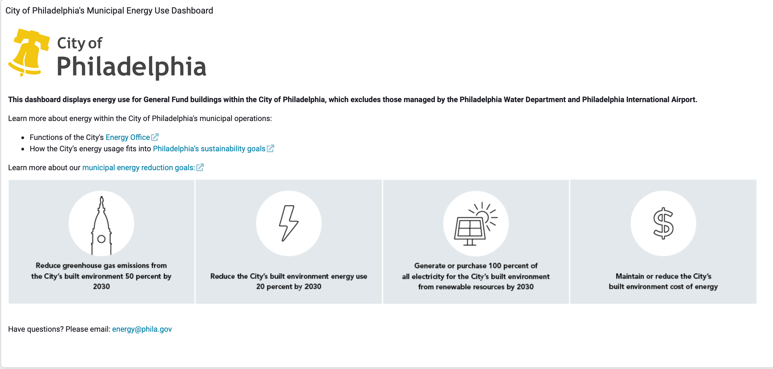
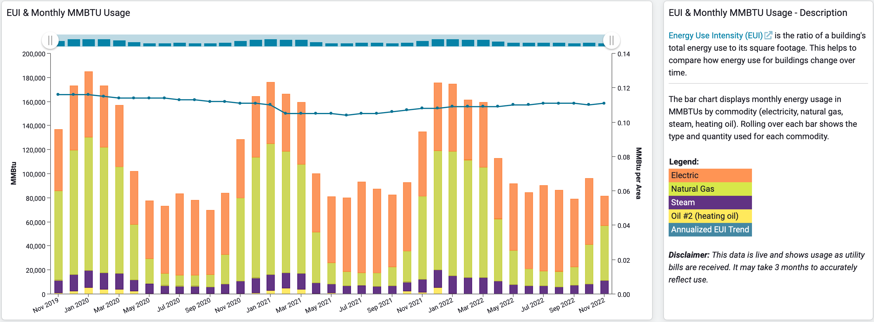
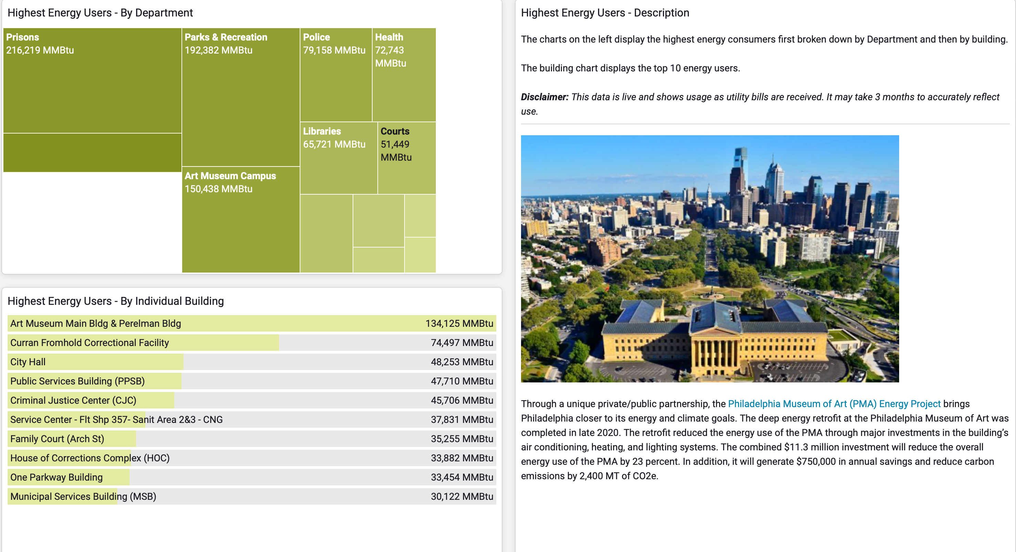
Extend your data sharing // embedded dashboards
Notes:
@Lalit

Slide 14
EnergyCAP CarbonHubTM
(ECH) overview
Notes:
@Dave

Slide 15

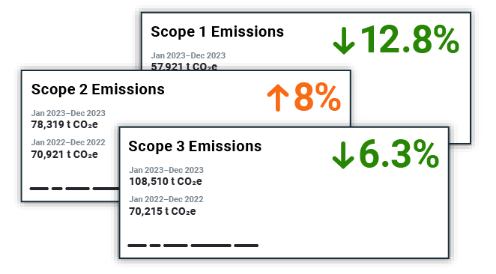
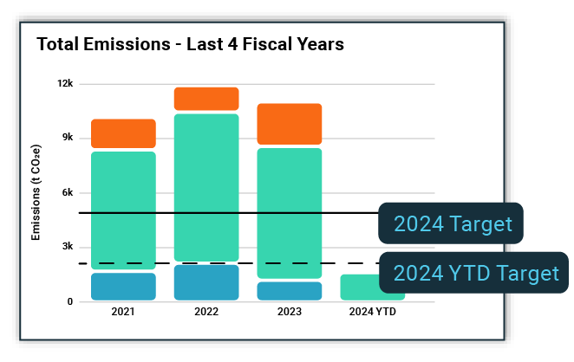
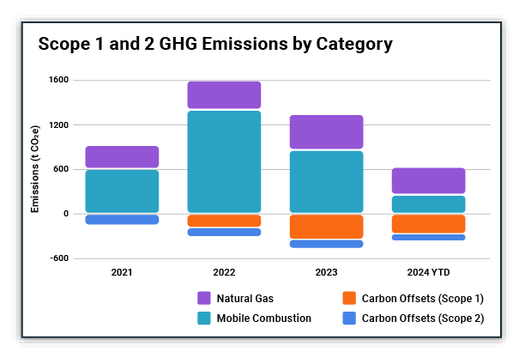
EnergyCAP CarbonHub // Financial-grade greenhouse gas accounting
Calculate
Calculate Scope 1, 2, and 3 data across your business.
Target
Set targets and track performance to your decarbonization goals.
Report
Access robust analysis and GHG reporting functionality.

Slide 16
EnergyCAP SmartAnalyticsTM
(ESA) overview
Notes:
@Lalit

Slide 17

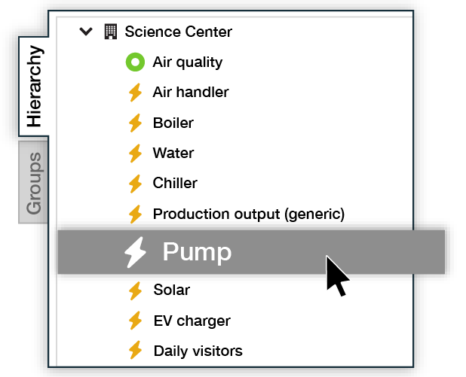
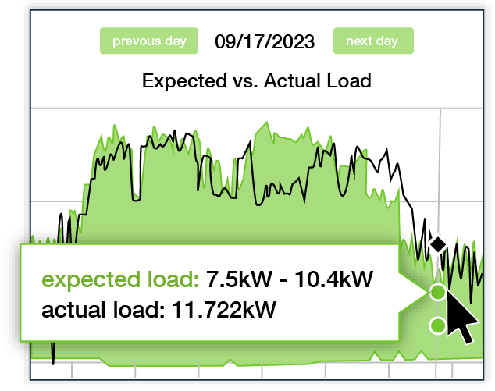
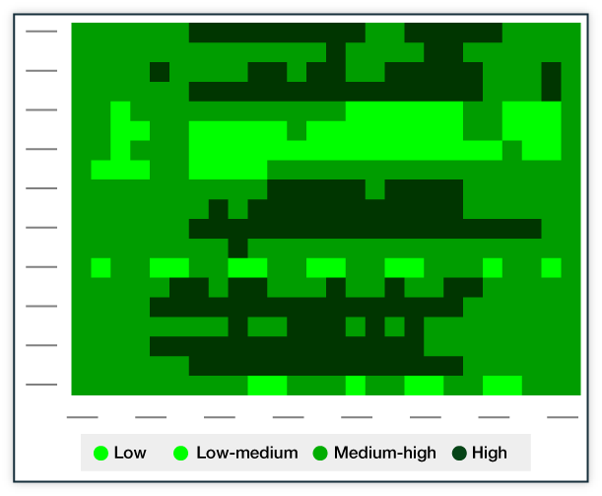
EnergyCAP SmartAnalytics // Real-time energy and sustainability analytics
Capture
Capture real-time data from virtually any source and type of device.
Monitor
Monitor data quality, detect outliers, and receive alerts and alarms.
Analyze
Access robust analysis and reporting functionality.
Notes:
@Lalit

Slide 18






























Integration, interoperability, security
Accounting platforms
Interval metering & device data
EUM and ESA
API Platform
  Robust resources available for developers to extend EnergyCAP features and integrate additional systems
  Dedicated developer website: https://developer.energycap.com
  https://developers.wattics.com
Integrations
  Built by EnergyCAP, clients, or third-parties
  Business-critical integration services
  Accounting systems (AP, GL)
  Interval data from private/public metering systems
  Property and asset management
  Building management systems
Other services
Building & asset management
BI & analysis tools
EUM/EAS API Platform
Security
  NIST and ISC standards-based security policies
  FedRAMP certified
  SOC2 certified
  Continuous monitoring, regular vulnerability scans, automatic threat detection
Additional integration services
  ENERGY STAR submission/reporting features
  Business intelligence and reporting add-on
Microsoft Azure
Analysis Services

Slide 19
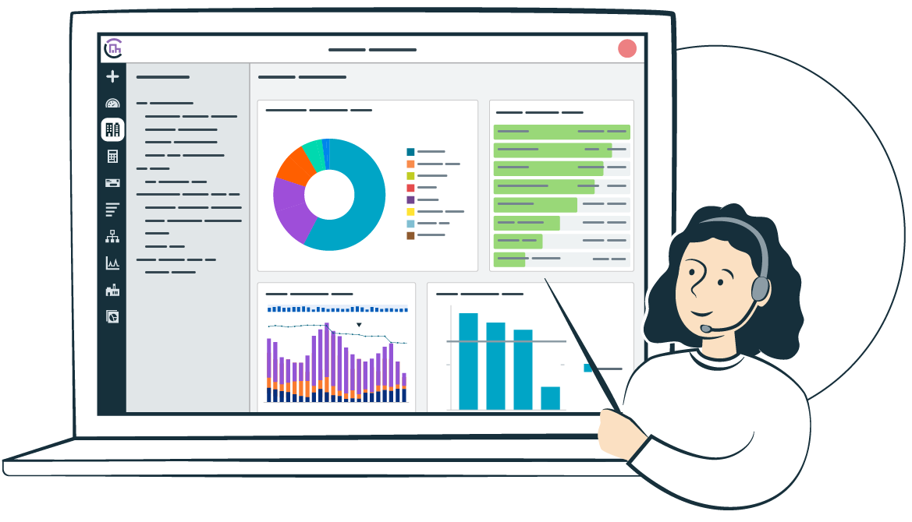

Professional startup and support services
Implementation project management
System integrations
Custom development
Bill CAPtureSM setup
Customer support
Customer success
Account management
CAPture services
Managed services
User training
Utility bill and energy information
Long-term value

Slide 20
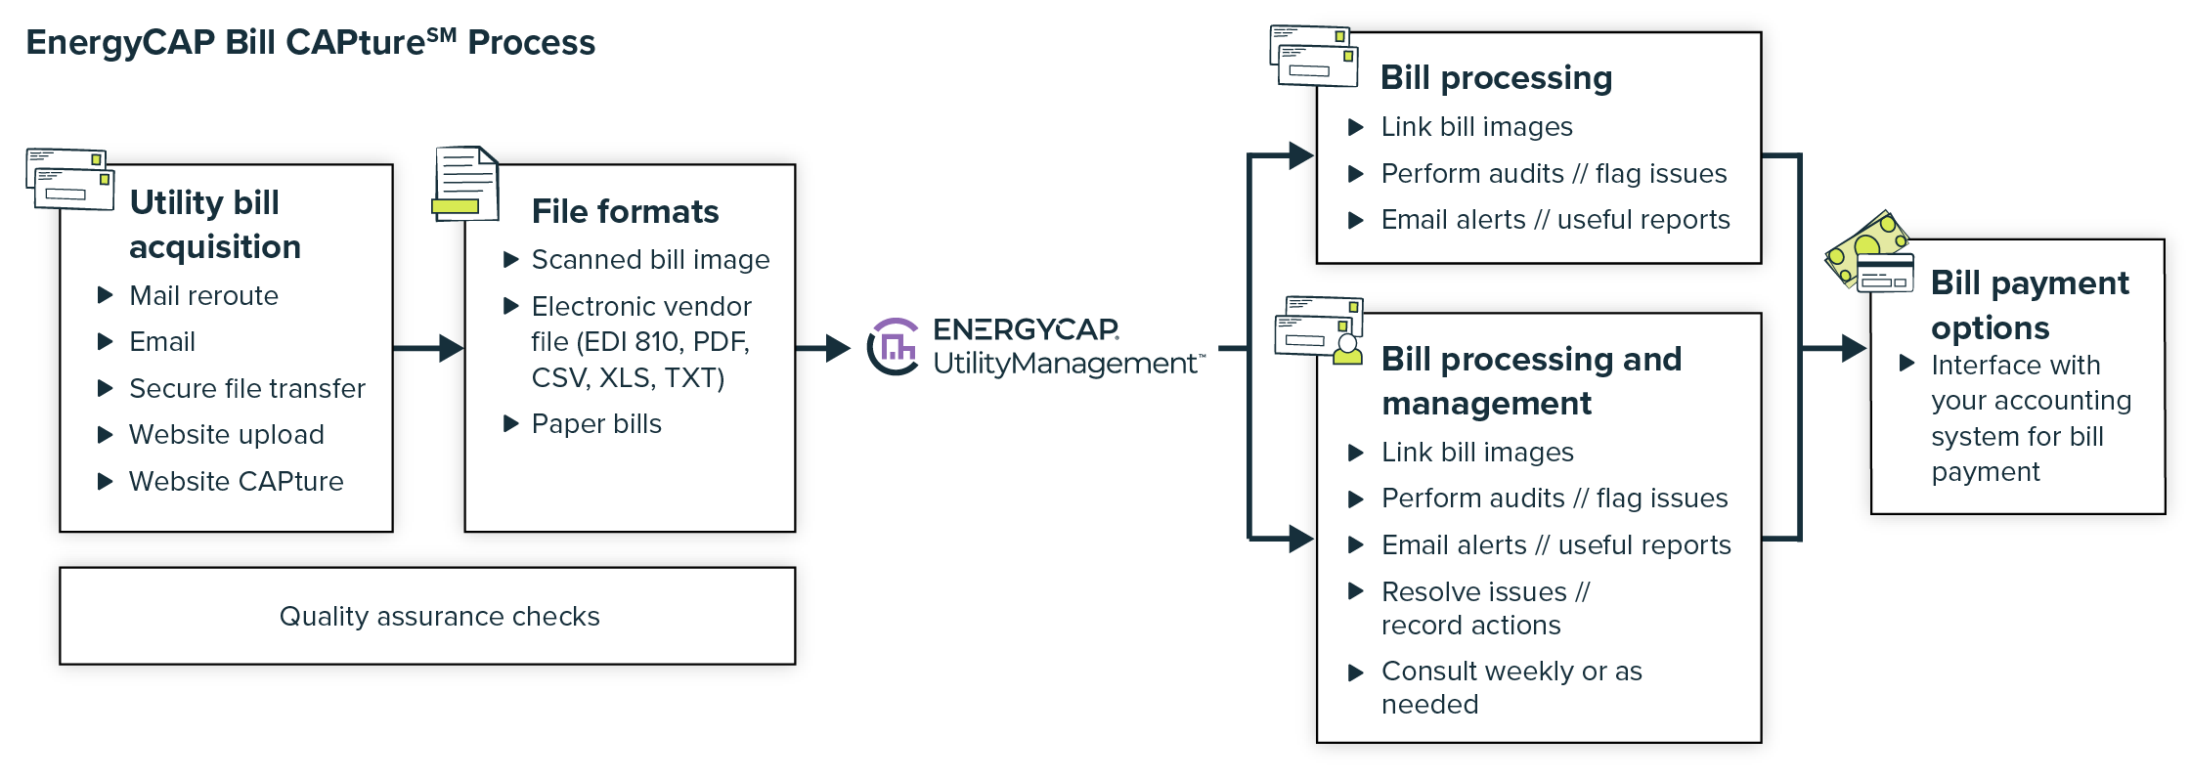
CAPture Services
EnergyCAP Bill CAPtureSM
If manual bill data entry consumes way too many hours of your valuable time, let us do the work for you via Bill CAPture, our specialized utility bill processing services.

Slide 21

Training services
We are committed to helping you and your team maximize the value from EnergyCAP. We offer online or in-person customized training to meet your specific needs.
EnergyCAP Academy and Certification
Build your EnergyCAP skill set at your own pace in the comfort of your home or office with video-based training courses.
Training conferences
Network with and learn from other EnergyCAP users from across North America at Catalyst, an annual EnergyCAP conference, and multiple Regional Training Conferences.
Custom training
If you are a new user or you’d like to refresh or expand your team’s skills, we can develop a customized learning session for your specific needs at your facility, online, or both.

Slide 22
Fee structure and options
License
  Annual based on number of meters (points of service) and advanced features
First-year setup and support
  Implementation, development, and training
  Data conversion, system setup, interfaces, training
  Development of reports, widgets, features, etc.
Database Hosting
  One database included
  Options for advanced environments and services
CAPture Services
  Initial enrollment of meters
  Ongoing transaction fees
Multiple hosting options
  Basic, Advanced, Optimum (FedRAMP/FISMA)
Multiple environment options
  Stand alone, multi-tenant, Azure, geo-location
Advanced services
  Access to SQL Server
  Single Sign On
  Multiple instances for testing/training

Slide 23
EnergyCAP Bill CAPture managed services offerings
 | Standard | Advanced | Premium | Not included
Access to Bill CAPtureSM Platform | ● | ● | ●
Automated Bill Delivery | ● | ● | ●
Bill Processing | ● | ● | ●
Processing Notifications | ● | ● | ●
Standard Bill CAPtureSM Support | ● | ● | ●
Report Distribution Management |  | ● | ●
Kickout Management |  | ● | ●
Flag Management |  | ● | ●
Customer Status Meetings |  | ● | ●
Access to Bill CAPtureSM Library |  | ● | ●
Vendor Engagement |  |  | ●
ENERGY STAR Portfolio Manager |  |  | ●
Management of Missing Bills |  |  | ●
Custom Reporting (including RDBI) |  |  |  | ●
Manual Bill Processing |  |  |  | ●
Bill Payment Workflow Actions |  |  |  | ●
Open/Close Accounts |  |  |  | ●

Slide 24
Thank you! www.EnergyCAP.com // Sales@EnergyCAP.com

